Slide 1
Work in animal care industry Kathy Reidy

Slide 2
Love animals?

Slide 3
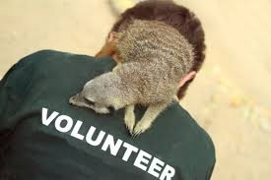
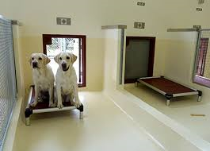
careers
Jobs in industry
volunteer

Slide 4
careers
GET PAID

Slide 5
learning
Caring for animals is a great way to learn
Owning / caring for animals is a responsibility
To be the best carers we can be- learn as much as we can!
Courses available to gain this knowledge
Skills based training for the practical

Slide 6
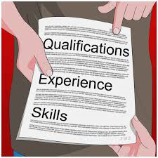
qualifications
Did you know there are many qualifications for our industry
Recommended within legislation- not mandatory
Employers recognise committed employees

Slide 7
Skills based training
Qualification: Certificate II Animal studies
12 units
Industry workplace supports students
Units cover:
Basic care of many species, feeding, housing, health etc
Working in a team-communication, safety etc
Hygiene practices-legislation & industry best practice

Slide 8
Follow on qualifications
Graduates of the Animal Studies Certificate II qualification may consider pursuing a career and further qualifications in their specific field:
Following are different fields/workplaces

Slide 9
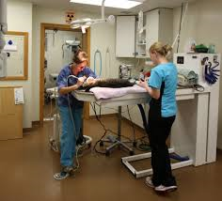
Vet clinic
Working as an assistant, or training to become a veterinary nurse (or veterinarian)
Animal medicine and surgery
Providing advice on pet care to owners

Slide 10
Hands on nursing care of a range of animals

Slide 11
Routine health care

Slide 12
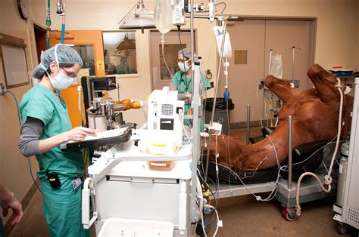
Emergency care

Slide 13
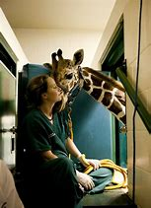
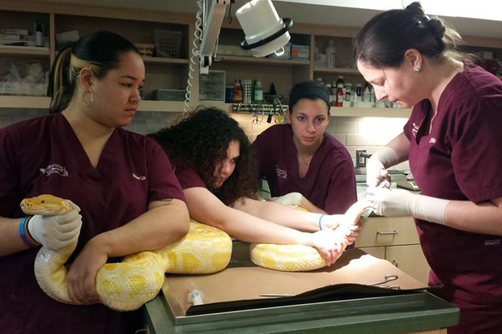
exotics

Slide 14
Veterinary nurse
Certificate II Animal Studies
Certificate IV Veterinary nursing
Diploma of veterinary nursing
(emergency And critical care)

Slide 15
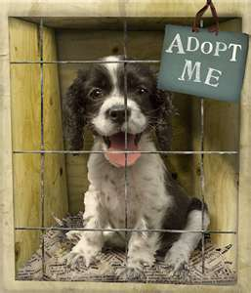
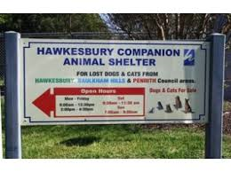
Animal shelter/pound
Caring for abandoned or surrendered animals

Slide 16
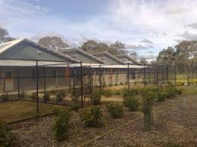
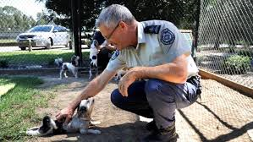
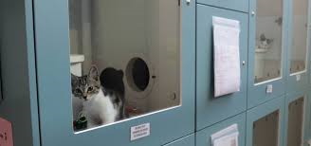
Animal shelter /pounds

Slide 17
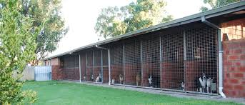
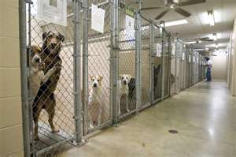
Boarding kennels
Providing temporary care for pets while their owners are away

Slide 18
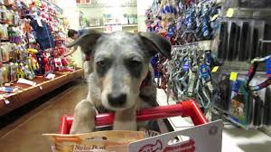
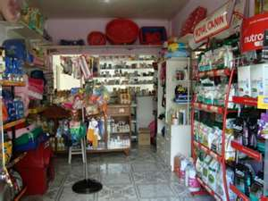
Pet shop
Caring for young pets before sale
Providing advice on pet care and information on various pet products to customers

Slide 19
Pet grooming (including mobile)
Handling animals appropriately for bathing and grooming
Providing advice to pet owners on animal care, especially their coat and external parasites

Slide 20
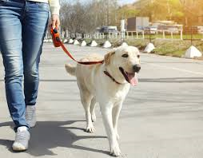
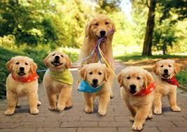
Pet walking
Offering regular walking services to people who are unable to exercise their pet.
Provide advice on pet nutrition and exercise requirements

Slide 21
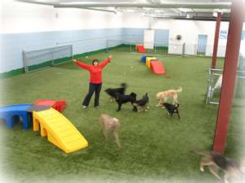
‘Doggie day care’
Offering regular or daily care and stimulation for pets where owners are unable to.
This may include walking, feeding, watering, playing, and/or just checking that pets at home alone are ok.

Slide 22
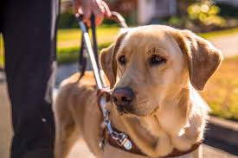
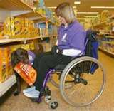
Trainer
Puppy preschool class facilitator
Training animals for general obedience or tricks for film/television
Training classes for dogs and their owners
Training animals for assisting people

Slide 23
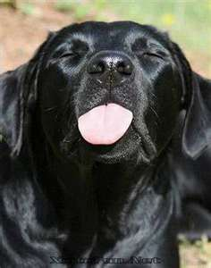
Behaviorist
Advising people on animal behavior and behavior modification
Training advise
Temperament assessing for shelter animals

Slide 24
Companion animal services
Certificate II Animal Studies
Certificate III Companion animal services
Certificate IV companion animal services (Electives focus behaviour/training)
Certificate IV companion animal services (Electives focus facility management)

Slide 25
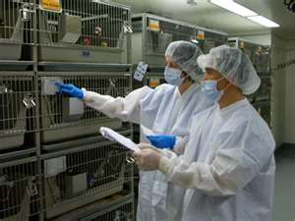
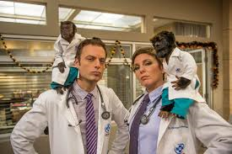
Laboratory
Feeding and caring for laboratory animals ensuring they are treated ethically and humanely
Variety of species
$$$

Slide 26
Animal technology
Certificate II animal studies
Certificate III animal technology
Jobs not advertised

Slide 27
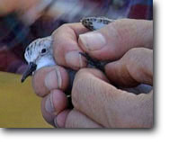
Wildlife
Providing specific care and rehabilitation to different species of native wildlife that are rescued due to illness/injury, loss of native habitat or other reasons

Slide 28
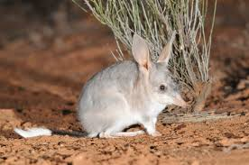
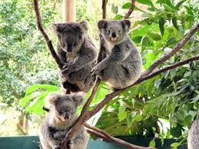
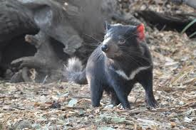
Zoo or wildlife facility
Providing daily care to a select group of wild animals living in a zoo.
This would include housing maintenance, feeding, exercise, health inspections, training, reproduction etc.
Ensuring the survival of near extinct species

Slide 29
Captive animals
Certificate II Animal Studies
Certificate III Captive animals
Certificate IV Captive animals

Slide 30
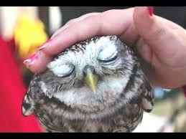
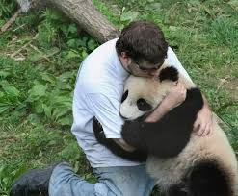
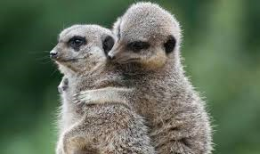
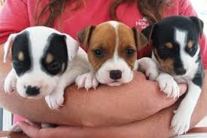
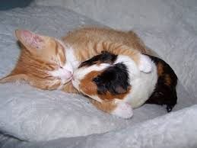
Which career path for you?

Slide 31
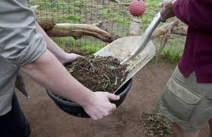
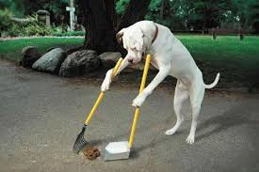
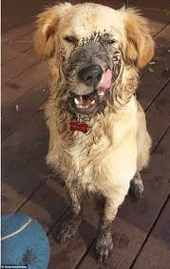
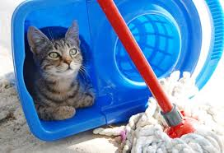
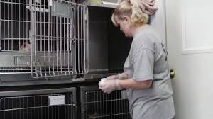
reality

Slide 32
kathy.reidy1@tafensw.edu.au
TAFE NSW

